Slide 1
2025 First Quarter Provider Webinar
Notes:
Good Afternoon Everyone, I would like to thank you all for joining our 4th quarter provider webinar. My name is Randal Bailey. I am your Provider Relations Specialist II for Arkansas Health and Wellness Northeast Region. Just a couple of house keeping rules. Please hold all questions to the end of the presentation. You will have the opportunity to ask questions through our Q&A feature listed. Please keep your phone muted. All PowerPoint slides will be added to the AHW website within a few days for educational purposes.

Slide 2
Disclaimer
Arkansas Health & Wellness has produced this material as an informational reference for providers furnishing services in our contract network. Arkansas Health & Wellness employees, agents, and staff make no representation, warranty, or guarantee that this compilation of information is error-free and will bear no responsibility or liability for the results or consequences of the use of this material.
The presentation is a general summary that explains certain aspects of the program but is not a legal document.
Although every reasonable effort has been made to assure the accuracy of the information within these pages at the time of publication, the program is constantly changing, and it is the responsibility of each provider to remain abreast of the program requirements. Any regulations, policies, and/or guidelines cited in this publication are subject to change without further notice.
All Current Procedural Terminology (CPT) are copyright 2025 of the American Medical Association (AMA). All rights reserved. CPT is a registered trademark of the American Medical Association. Applicable Federal Acquisition Regulation (FARS/DFARS) restrictions apply to government use. The AMA assumes no liability for data contained or not contained herein.
Notes:
Arkansas Health and Wellness has produced this material as an informational reference for providers supplying services in our contract network. This information is to inform you that the presentation is current when it was published. We do understand that policies change frequently so we do recommend that you utilize our websites to make sure you have all updated information.

Slide 3
Agenda
Join Our Email List
Clinical and Payment Policy Updates
Availity Essentials
Appointment Availability
Prior Authorizations
Pre-Auth Check Tool
Secure Provider Portal
Self-Led Provider Trainings
Risk Adjustment
Quality
Contact Information
Notes:
Here is our agenda for the day, we are going to cover **read slide

Slide 4
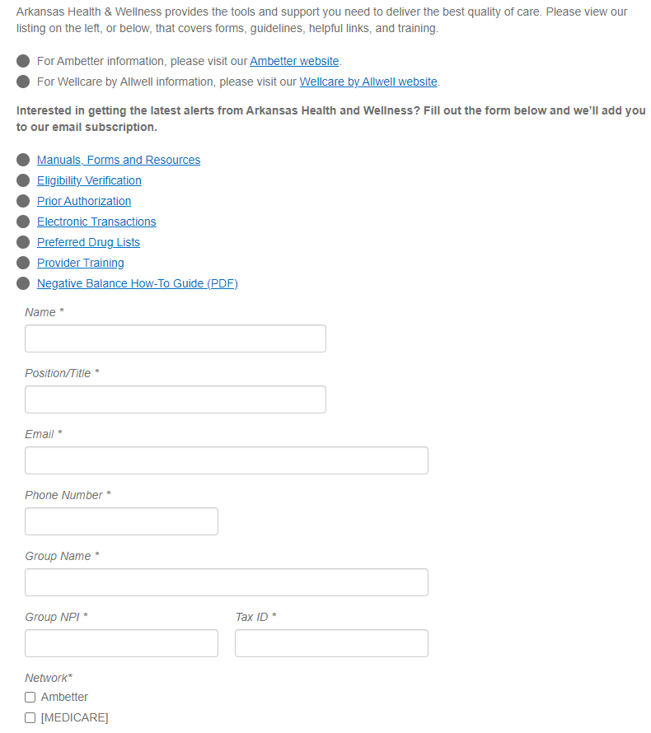
Join Our Email List Today
Sign up to receive updates:
https://www.arhealthwellness.com/providers/resources.html
Choose the network you wish to receive information on: Ambetter or Wellcare by Allwell
Notes:
Please be sure to join our mailing list to stay up to date with AHW communications. Sign up can be done by visiting our website at arhealthwellness.com and by clicking on the “For Providers” tab you will be directed to complete this form.

Slide 5
Clinical and Payment Policy Updates
Notes:
Let’s go ahead and get started with the Clinical and Payment Policy Updates

Slide 6
Clinical and Payment Policy Updates (1 of 2)
Arkansas Health & Wellness routinely amends or implements new policies that can be found on its website.
Recent Clinical Policy Updates: Ambetter
Hospice Services, effective November 1, 2024
Reduction Mammoplasty and Gynecomastia Surgery, effective November 1, 2024
Recent Payment Policies: Ambetter
EEG in the Evaluation of Headache, effective November 1, 2024
Allergy Testing and Therapy, effective November 1, 2024
Notes:
Ambetter have several newly implemented policies that are available on our public website. As you can see several new clinical and payment policies with an effective date of 11/1/24, has just gone into effect.

Slide 7
Clinical and Payment Policy Updates (2 of 2)
Notes:
These policies can be located on the Provider Resources section of the “For Providers” tab by scrolling down to “Clinical and Payment policies.

Slide 8
Availity Essentials (1 of 3)
Arkansas Health & Wellness has chosen a new platform for the Secure Provider Portal. Effective November 18, 2024, you can validate eligibility and benefits, submit claims, check claim status, submit authorizations, and access Arkansas Health & Wellness payer resources through Availity Essentials.
If you are already working in Essentials, log in to your existing Essentials account to enjoy these benefits.
Use Availity Essentials to verify member eligibility and benefits, submit claims, check claim status, submit authorizations, and more.
Look for additional functionality in Arkansas Health & Wellness’ payer space on Essentials and use the heart icon to add apps to My Favorites in the top navigation bar. Access Manage My Organization — save provider information in Essentials and auto-populate it to save time and prevent errors.
If you are new to Availity Essentials, getting your Essentials account is the first step toward working with Arkansas Health & Wellness on Availity.

Slide 9
Availity Essentials (2 of 3)
Designate an Availity Administrator for Your Provider Organization
Your provider organization’s designated Availity administrator is the person responsible for registering your organization in Essentials and managing user accounts. This person should have legal authority to sign agreements for your organization.
How does this impact me? | What is my next best step?
I am the administrator. I am the designated Availity administrator for my organization. | Visit Register and Get Started With Availity Essentials to enroll for training and access other helpful resources.
I am not the administrator. I am NOT the designated Availity administrator for my organization. | Your designated Availity administrator will determine who needs access to Availity Essentials on behalf of your organization and will add user accounts in Essentials.
I am not sure. I am not sure who will be the designated Availity administrator for my organization. | Share this information with your manager to help determine who will be the designated Availity administrator for your organization.

Slide 10
Availity Essentials (3 of 3)
Join one of our upcoming free webinars, Availity Essentials Overview for Arkansas Total Care, to learn additional tips for streamlining your workflow. We’ll show you how to verify eligibility and benefits, submit claims, check claim status, submit authorizations, and more.
We’re excited to welcome you to Availity Essentials, helping you transform the way you impact patient care with Arkansas Total Care. If you need additional assistance with your registration, please call Availity Client Services at 1-800-AVAILITY (1-800-282-4548). Assistance is available Monday through Friday from 7 a.m. to 7 p.m. CT.
For general questions, please reach out to your Arkansas Total Care Provider Relations Representative.

Slide 11
Appointment Availability & Wait Times
Notes:
Moving on to Appointment Availability & Wait Times

Slide 12
Appointment Availability & Wait Times (1 of 2)
Ambetter follows the accessibility and appointment wait time requirements set forth by applicable regulatory and accrediting agencies. Ambetter monitors participating provider compliance with these standards at least annually and will use the results of appointment standards monitoring to ensure adequate appointment availability and access to care and to reduce inappropriate emergency room utilization. The table below depicts the appointment availability for members:
Appointment Type | Access Standard
PCPs - Routine visits | 30 calendar days
PCPs - Adult Sick Visit | 48 hours
PCPs - Pediatric Sick Visit | 24 hours
Behavioral Health – Non-Threatening Emergency | 6 hours
Specialist | Within 30 calendar days
Urgent Care Providers | 24 hours
Behavioral Health Urgent Care | 48 hours
After Hours Care | Office number answered 24 hours/7 days a week by answering service or instructions on how to reach a physician
Emergency Providers | 24 hours a day, 7 days a week
Notes:
Ambetter follows the accessibility and appointment wait time requirements set forth by applicable regulatory and accrediting agencies. Ambetter monitors participating provider compliance with these standards at least annually and will use the results of appointment standards monitoring to ensure adequate appointment availability and access to care and to reduce inappropriate emergency room utilization. The table below depicts the appointment availability for members:

Slide 13
Appointment Availability & Wait Times (2 of 2)
Wellcare by Allwell follows the accessibility and appointment wait time requirements set forth by applicable regulatory and accrediting agencies. Wellcare by Allwell monitors participating provider compliance with these standards at least annually and will use the results of appointment standards monitoring to ensure adequate appointment availability and access to care and to reduce inappropriate emergency room utilization.
The table the right depicts the appointment availability for members.
Type of Care | Accessibility Standard*
Primary Care
Emergency | Same day or within 24 hours of member’s call
Urgent care | Within 2 days of request
Routine | Within 21 days of request
Specialty Referral
Emergency | Within 24 hours of referral
Urgent care | Within 3 days of referral
Routine | Within 45 days of referral
Maternity
1st trimester | Within 14 days of request
2nd trimester | Within 7 days of request
3rd trimester | Within 3 days of request
High-risk pregnancies | Within 3 days of identification or immediately if an emergency exists
Dental
Emergency | Within 24 hours of request
Urgent care | Within 3 days of request
Routine | Within 45 days of request
The in-office wait time is less than 45 minutes, except when the provider is unavailable due to an emergency.
Notes:
Wellcare by Allwell also follows the accessibility and appointment wait time requirements set forth by appropriate regulatory and accrediting agencies. Wellcare by Allwell monitors active provider compliance with these standards at least annually and will use the results of appointment standards monitoring to ensure adequate appointment availability and access to care and to reduce inappropriate emergency room utilization. The table below depicts the appointment availability for members.

Slide 14
Prior Authorizations
Notes:
Moving On To Prior Authorizations

Slide 15
How to Secure Prior Authorization
Prior Authorizations can be requested in the following ways:
Secure Provider Portal — preferred and fastest method
Ambetter and Wellcare by Allwell: Provider.ARHealthWellness.com
Phone
Ambetter: 1-877-617-0390 (TTY: 1-877-617-0392)
Wellcare by Allwell: 1-855-565-9518 (TTY: 711)
Fax
IP and OP paper forms are available on the website under Provider Resources.
Ambetter: 1-866-884-9580
Wellcare by Allwell: 1-833-562-7172
After normal business hours and on holidays, calls are directed to the plan’s 24-hour Nurse Advice Line. Notification of authorization will be returned via phone, fax, or web.
Notes:
Prior authorization can be obtained in 3 ways for all lines of business.
First, by using the web portal.
Next, they can be phoned in to the numbers listed on the slide for each line of business.
Or they can be faxed in using the Inpatient or Outpatient forms that are available on the websites under Provider Resources.

Slide 16
Pre-Auth Check Tool (1 of 2)
Notes:
We have a very user-friendly tool on the website that allows providers to check and see if a prior authorization is required.
The Pre-Auth tool sits on our public website, so no login is required to access it.
It can be found under the provider resources tab.

Slide 17
Pre-Auth Check Tool (2 of 2)
Notes:
It is the responsibility of each provider to confirm if a service requires a prior authorization.
Use the Pre-Auth Needed tool to see if a service needs a Prior Authorization
You will need to answer the questions with the radio buttons before the box to enter your code will appear
-Green ‘N’ for no auth
-Red ‘Y’ for auth required
-Blue ‘C’ for conditional

Slide 18
Secure Provider Portal
Notes:
Moving on to the Secure Provider Portal

Slide 19
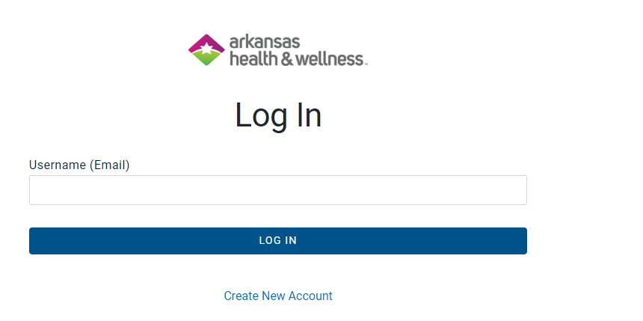
Secure Provider Portal — Create An Account
Registration is free and easy
Provider.ARHealthWellness.com
Notes:
Registering for access to our portal is simple, you may do so by visiting our website at arhealthwellness.com and clicking on the login tab. And clicking the link to Create a New account.

Slide 20
Secure Provider Portal — Features
A member eligibility overview page that reflects all critical data in a single view
Ability to submit and track the status of claim reconsiderations online
Expanded free text fields for reconsideration comments and explanations
Attach required documentation when filing a reconsideration
Upload records for care gap information.
Receive push notifications regarding reconsideration status changes
Void/Recoup option on claims already adjudicated by the health plan (refer to page 92 of the manual available in the Portal for instructions)
Notes:
By creating a Portal account allows providers to have the ability to view member eligibility, you can submit and track the status of claim reconsiderations. You can also attach documentation to the reconsideration and receive push notifications regarding reconsideration status changes.
And there is an option to void or recoup on claims already adjudicated and instructions for this feature can be found on page 92 of the manual inside of the portal.

Slide 21
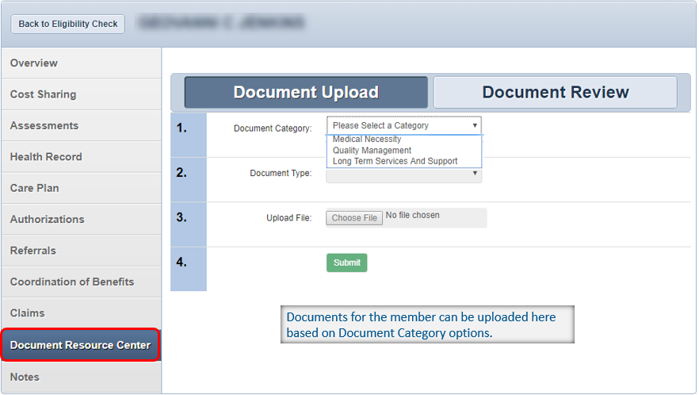
Patient Overview — Document Resource Center
Notes:
The Document Resource Center tab allows you to upload and review documents for the member based on a document category. The document category and document type are pre-populated fields. Once you’ve selected the category and type click choose file, select the document you want to upload and hit submit

Slide 22
Self-Led Provider Trainings
Notes:
Now we move on to the Provider self Led Trainings.

Slide 23
Self-Led Provider Trainings (1 of 2)

Slide 24
Self-Led Provider Trainings (2 of 2)
Notes:
https://www.arhealthwellness.com/providers/resources/provider-training/Secure_Provider_Portal_Quick_Start_Guide.html

Slide 25
Risk Adjustment

Slide 26
Risk Adjustment Overview
Risk adjustment is a tool used to predict the likely use and cost of healthcare based on an individual’s healthcare status or Risk Adjustment Factor (RAF) score, which is contingent on factors such as age, gender, community status, and severity of health conditions.
RAF Score
Age | + | Gender | + | Demographic | + | Diagnosis | + | Original Reason for Entitlement

Slide 27
Hierarchical Condition Categories (HCC)
HCCs reflect hierarchies among related disease categories.
Only the most severe HCC within hierarchy is calculated in RAF.
HCCs captured from unrelated diagnosis are cumulative.
CMS determines the qualifying ICD-10 diagnosis codes for each category and assigns the risk factor value.
Not all diagnoses map to an HCC.
Some diagnoses map to multiple HCCs.
Notes:
Risk adjustment coding focuses on diagnosis coding using the ICD-10-CM code set. Select ICD-10 diagnosis codes map to specific Hierarchical Condition Categories, or HCCs. CMS assigns a value to each category in the HCC Model. HCC methodology accounts for differences in beneficiary risk factors that can affect quality outcomes or medical costs. It is important to point out that not all diagnosis codes map to an HCC, so ICD-10 coding accuracy is crucial.

Slide 28
Importance of Risk Adjustment
Identify actual disease burden of member and patient population
Improved quality of care through disease management programs
Ensure coverage of health expenditures and appropriate risk premiums
Notes:
Risk adjustment helps communicate patient complexity and paints a picture with words of the patient’s overall health status profile. It also ensures improved quality of care by identifying members who would benefit from disease management programs. And risk adjustment is designed to ensure there is appropriate risk premiums to cover medical cost for members. The success of risk adjustment depends on accurate documentation and diagnosis coding from our providers.

Slide 29
RA Program Goals
Assist providers with engaging patients and actively address chronic conditions
Ensure risk-adjusted conditions are coded accurately and documented annually
Develop relationships with provider partners to serve as a resource and assist with strategy to target patients
Increase recapture and persistency rates
Decrease members without visit (MWOV) rates
Notes:
Risk Adjustment Program Goal
Our goal is to help providers and staff comprehend and ultimately apply risk adjustment and quality best practices into each of the Practice’s workflow, as well as protect the integrity and accuracy of reported conditions for improved quality of care and ultimately improved health status of our members.
Participation in risk adjustment program initiatives can assist providers with patient engagement strategies to decrease members without visit (MWOV) rates and increase assessment and recapture rates.

Slide 30
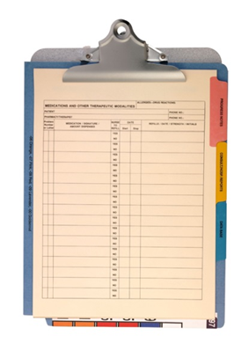
Focus on Documentation
Specificity
Document condition(s) assessed and what is being done for that condition (Rx, labs, referrals, monitoring)
Accuracy
Documentation must support the diagnosis reported
Watch for conflicting data within note
Document cause/effect relationships
Complete
Incorporate/document relevant findings into progress note
Report diagnosis codes at least once per calendar year
Consistency
Chief complaint
HPI, PMH, ROS, EXAM
Comorbidities affecting patient care
Use standard abbreviations
CMS acceptable signature
Handwritten
Electronic
CMS must be able to determine rendering provider
Subjective
Objective
Assessment
Plan
Documentation should paint a picture with words of the patient’s condition and what occurred during each visit.
Notes:
Managing chronic conditions and closing gaps in care fulfil critical components in a member’s plan of care and relies on providers to capture a comprehensive health status for every member which includes maintaining complete and accurate medical records. The importance of consistent, complete documentation in the medical record cannot be overemphasized. Without such documentation accurate coding cannot be achieved.
Documentation should paint a picture with words of the patient’s condition and what occurred during each visit.
Assess the status of conditions for which interventions are recommended or underway. Code all documented conditions that coexist at the time of the encounter/visit and require or affect patient care treatment or management. This includes ongoing chronic conditions, even if stable.
Be clear and consistent throughout the medical record when documenting details of a condition. A diagnosis cannot be validated when the record contains conflicting information.
Document to the highest degree and code to the highest specificity. Include condition status and other pertinent details to the highest known degree (Chronic/Acute/Benign/Malignant) along with any complications, comorbidities, and/or causal relationships (Left upper extremity weakness due to CVA). And Make sure documentation is consistent throughout.
The ICD-10 diagnosis code must match the wording used in documentation. Explicitly state the diagnosis and follow the official conventions and guidelines for coding and reporting. Do not code conditions that have been treated or no longer exists. Do not use “history of” to describe a condition currently undergoing treatment.
Conditions mentioned in Past Medical History or Active Problem List must be supported in another section of the medical record to verify the condition is active. The best practice is to include evidence of current review in the form of medication, referrals, order of lab tests, etc. in the assessment and plan.
Detailed documentation will lead to coding specificity!

Slide 31
Medical Record Requirements
Face-to-face encounter
Correct entry for date of service
Two patient identifiers on every page
Acceptable provider type
Acceptable service type
Proper signature with credentials
Clear and legible handwriting
Use of standard abbreviations

Slide 32
Risk Adjustment Program Initiatives
Continuity of Care (CoC)
Provider incentive program — Increases visibility into members' existing medical conditions for chronic condition management (PCP only).
In-Office Assessment (IOA)
Provider incentive program — Supports early detection and ongoing annual assessment of chronic conditions for patients to help improve health outcomes.
Clinical Documentation Improvement (CDI)
Complimentary review of provider coding and documentation trends with education tailored to review findings.
Annual Chart Review Projects
Vendor works with providers and health plan to retrieve medical records and accurately report members health status in compliance with RA guidelines.
Notes:
(Describe programs listed in slide)

Slide 33
2025 Continuity of Care (CoC)
CoC is a claims-based provider engagement program specific to Medicare and Marketplace risk adjustment. The CoC program provides increased visibility of member’s health conditions for better quality of care through chronic condition management and prevention.
Primary care providers (PCPs) can earn up to $400–$450 per member for proactively coordinating preventive medicine and thoroughly assessing patients’ health conditions.
Incentive Eligibility Requirements
Provider within assigned TIN must:
Complete a qualified visit with member during the program year (January–December)
Prospectively address patient conditions at the point of care utilizing appointment agenda
Include ICD-10 code(s) for all active conditions (supported in the medical record) on claim for DOS
Submit completed agenda with 100% of conditions assessed
The 2025 CoC program launches February 12 and runs through December 31.
Notes:
CoC is a proactive provider engagement program incentivizing providers incrementally for their work on addressing chronic conditions that are risk adjusted. Goal is to recognize and reward providers who collaborate with AHW to deliver quality care and improve documentation of care for members.
Indicate for each condition on agenda:
Gap Assessed and Documented as Appropriate
Assessed, Not Present
Not Assessed, Addressed Previously
Not Assessed, Member Referred
Providers are assigned a Risk Adjustment Specialist who serves as a resource to educate, train, and provide reporting to ensure success.

Slide 34
2025 Continuity of Care Plus (CoC+)
The CoC+ program is a separate provider incentive program that delivers member insights specific to Quality reporting.
Complete additional portions of the appointment agenda to be eligible for additional compensation!
Additional incentive opportunity:
$150
$100
per Medicare Agenda
per Marketplace Agenda
All boxes related to the high risk, care guidance, clinical, and/or drivers of health portions must be checked and verified where applicable.
All CoC+ insights must be received by July 1 to be eligible for incentive(s).
Notes:
CoC+ is a proactive provider engagement program incentivizing providers for their work on addressing members’ care and quality gaps. CoC+ incentives can be earned in addition to the CoC incentive by completing high risk, care guidance, clinical, and/or drivers of health portions of the appointment agenda, where applicable

Slide 35
Data Integrity
Risk adjustment payment methodology used by the Department of Health & Human Services (HHS) for health insurance marketplace mandate the timely and accurate submission of members’ diagnostic data, subject to annual review.
To ensure ICD-10-CM codes obtained from claims submissions are accurate and conform to applicable risk adjustment regulation, annual medical record retrieval and review is required. For this reason, we appreciate your cooperation in providing requested medical records through our HIPAA-contracted business partners or to the health plan directly.
Notes:
(Read slide)
NOTE: Providers may receive a request for medical records for multiple chart projects such as an internal health plan, state, and/or federal audit or any NCQA program such as HEDIS

Slide 36
Risk Adjustment Medical Record Requests from Behavioral Health Providers
Medical record requests include:
Progress notes including session start and stop time, treatment type and frequency, diagnosis, treatment plan, symptoms, prognosis, and patient progress
Treatment summary including client name, date of birth, diagnosis, dates of service, general reason for treatment, basic description of client symptoms, treatment plan goals, session modality/frequency (average), length of sessions, progress, and prognosis. A few sentences for each of these areas is fine.
Private psychotherapy notes should remain separate from the patient’s chart and are not part of the medical record request for risk adjustment purposes.
All documentation (progress notes, treatment summaries, etc.) must be legible, be signed by the provider rendering the services, and include provider’s credentials.
Notes:
Multiple handwritten encounters in the same handwriting, on the same page will be reviewed and should be submitted if one of the encounters is signed. NOTE: An attestation will be needed. For handwritten notes, consider using pre-printed note or stationery that includes the provider’s printed name and credentials.

Slide 37
Tools for Engagement
Prospective programs are designed to proactively make an event occur to capture the diagnostic data in the current experience period.
There are various types of risk adjustment programs that can ensure complete and accurate data is submitted to CMS.
EMR Point of Care Alerts
Optum IOA/Vatica Health (Vendors)
Prospective
Review
Secure Provider Portals

Slide 38
EMR Integration
Benefits of automated data exchange between payor and provider:
Increased data accuracy
Improved workflow
Decreased administrative burden
Enhanced patient care
Better health outcomes
Epic Payor Platform
Healow
Moxe
Athena
Active EMR with point-to-care alerts:
Future Connections: Veradigm (Practice Fusion, All Script, NexGen), VIM, and Oracle
Notes:
Automated exchange of patient health data between the payor and provider allows for increased data accuracy, improved workflow, decreased administrative burden, resulting in enhanced patient care, and improved health outcomes. Currently, bidirectional feed can be seamlessly integrated into Epic Payor platform, Healow, Moxe, and Athena EMR systems.
(COC+ data will not be available until June)

Slide 39
Summary of Best Practices
Comply with medical record requests in a timely manner
Utilize program data and integrate into workflow
Assess ALL active conditions annually
Be clear and consistent in medical record
Build rapport with RA specialists to close care gaps
Follow timely filing rules for claim submissions
Code to the highest specificity
Include ICD-10 code on claim

Slide 40
Quality Improvement

Slide 41
2025 Wellcare Partnership for Quality (P4Q) Program
The 2025 P4Q bonus program give providers the opportunity to earn an incentive by addressing preventive care measures and closing gaps in members’ care.
By December 31, 2025
Contact patients to schedule an appointment. At the visit, order appropriate tests and preventive screenings. Take action to help patients complete all preventive care and close care gaps.
By January 31, 2026
Document care and treatment (not diagnosis) in the patient’s medical record and submit all applicable diagnoses codes on claims, encounter files, and/or approved NCQA supplemental electronic flat files containing all relevant ICD-10, CPT, and CPT II codes.
Review and counsel on results of tests and screenings with patients.

Slide 42
2025 Ambetter Pay for Performance (P4P) Program
The 2025 P4P bonus program has four payment cycles. In Cycles 1–3, earnings less than $100 will automatically be rolled over to the next payment cycle. Any balances under $100 will be disbursed in Cycle 4. Payments for medication adherence measures CBP (controlling high blood pressure) and GSD (diabetes HbA1c ≤ 9) will be included only in Cycle 4.
2025 Measure List | Measure Incentive | Target 1 Pays 75% of Incentive | Target 2 Pays 100% of Incentive
Cervical Cancer Screening (CCS) | $25 | 56.90% | 65.00%
Colorectal Cancer Screening (COL) | $25 | 56.90% | 62.80%
Child and Adolescent Well-Care Visits (WCV) | $25 | 50.50% | 59.60%
Controlling High Blood Pressure (CBP) | $25 | 67.80% | 72.90%
Glycemic Status Assessment for Patients with Diabetes <9 (GSD) | $25 | 72.50% | 77.40%
Eye Exam for Patients with Diabetes (EED) | $25 | 42.40% | 52.90%
Patients with Diabetes Kidney Health Evaluation (KED) | $25 | 46.70% | 55.40%
Breast Cancer Screening (BCS) | $25 | 71.50% | 75.70%
Chlamydia Screening in Women (CHL) | $25 | 43.80% | 51.50%
Plan All-Cause Readmissions (PCR) | $25 | 64.00% | 55.50%

Slide 43
CPT II Coding
It’s important to use accurate CPT II and HCPCS codes to close care gaps and improve data collection for performance measurement. When you verify that you performed quality procedures and closed care gaps, you’re confirming that you’re providing the best care to our members.
Effective January 1, 2022, Wellcare adds CPT II and HCPCS codes to the fee schedule at a rate of $0.01. This allows codes to be billed without denial for being “non-payable,” resulting in fewer dropped codes and better reporting.

Slide 44
Medicare Annual Wellness Visit (AWV)
Schedule a visit with your member today!
Wellcare members are covered for: |  |  | CODES
Annual Wellness Visit (AWV) | This unique to Medicare visit allows you and your patient to meet and discuss their health to create a personalized prevention plan. | 1 per calendar year | G0438, G0439*
Routine Physical Exam (RPE) | This Medicare Advantage Supplemental beneft is a comprehensive physical examination to screen for disease and promote preventative care. | 1 per calendar year | 99381-99387* (new patient) 99391-99397** (established patient)
*Contracted Federally Qualifed Health centers (FQHC) must include G0468 when billing AWV. **Can be billed with the AWV with a modifer 25.

Slide 45
AWV Topic Discussions
Topics to discuss during your patient’s Annual Wellness Visit (AWV):
Update patient’s medical record: including demographics, other treating providers and family history
Conduct a Social Determinants of Health assessment
Discuss Advanced Care planning
Screen for cognitive impairment, including depression, mental wellness and emotional health
Conduct medication reconciliation and extend day fill opportunities (mail order or 90 days at retail)
Complete pain and functional assessments; including use of Durable Medical Equipment (DME)
Assess bladder leakage and care options
Create a preventative screening schedule and refer members for tests, labs, X-rays (eye exams, colonoscopy, mammograms), counseling and care programs
Complete the health risk assessment, including functional abilities, ADLS, instrumental ADLs and create an action plan
Create patient’s list of balance/fall risk factors and conditions; including interventions and treatment options
Check routine measurements: height, weight, blood pressure, etc.
Review current opioid prescription and screen for potential Substance Use Disorders (SUDs)
Topics to discuss during your patient’s Routine Physical Visit:
Health History
Vital signs
Heart, lung, head/neck, abdominal, neurological, dermatological, extremities and gender specific exam

Slide 46
AWV Quick Reference & Tips
For People with Diabetes
Annual diabetic retinal eye exam
Review adherence of diabetes medications (consider 90-day fills for maintenance medications) and evaluate the addition of a statin to help prevent heart and blood vessel diseases
Blood pressure monitoring
Testing and control of HbA1c
Kidney function tests
Medical attention for nephropathy
As Needed
Osteoporosis screening and management after fracture
Care for Older Adult
Important Cancer Screenings
Colon cancer screening (Colonoscopy, Fit DNA test, Cologuard)
Breast cancer screening
Prostate cancer screening
Lung cancer screening
Care for Older Adults
Medication review and reconciliation by physician
Functional status assessment
Pain assessment
Advance care planning
Depression screening
Adult Vaccinations
COVID-19 – initial and follow-up
Influenza – yearly
Pneumococcal – one time (may need booster)
Meningococcal
Tetanus, diphtheria, pertussis (Td/Tdap)
Zoster (shingles)
Hepatitis A
Hepatitis B
TIPS to Ensure Healthy Outcomes
Always share tests and screenings results with members, and discuss how they can access them, via a patient portal
Be sure to submit all applicable conditions, via IDC 10 codes
Leverage CPT Category II codes to ensure outcomes in order to reduce chart collection events

Slide 47
Medication Adherence
Quality Measures
Below are three examples of Centers for Medicare and Medicaid Service Star measures which use adherence to evaluate health plans.
Beneficiaries, ages 18 years and older, who had at least two fills of medication(s) listed below on different dates of service and were 80% or more adherent to their medications.
Quality Measure | Description
Medication Adherence for Diabetes (DIAB)* | Oral antidiabetic medications defined as Biguanides, Sulfonylureas, Thiazolidinediones, DPP-IV inhibitors, GLP-1 receptor agonists, Meglitinides, and SGLT2 inhibitors
Medication Adherence for Hypertension (RASA)** | Renin-Angiotensin System (RAS) antagonists defined as ACE inhibitors, ARBs, or Direct Renin Inhibitors
Medication Adherence for Cholesterol (Statins) | Statins
Exclusions
End-stage renal disease (ESRD), Hospice, *Insulin use (DIAB only), **Sacubitril/Valsartan use (RASA only).

Slide 48
Medication Adherence Tips
RxEffect LIS Indicator: If the LIS flag reflects ‘Yes,’ your patient is eligible to fill a 90-day prescription for the same cost as a 30-day prescription.
Best practices to promote medication adherence
Prescribe 90-day prescriptions supply
For chronic medications, prescribe a 90-day quantity.
Review medications regularly
During each visit, review all medications with the patient.
When possible, remove medications no longer needed and reduce dosages.
Check for understanding
Make sure your patients knows why you are prescribing a medication.
Clearly explain what they are, what they do and how to manage potential side effects.

Slide 49
Resources Available to Members
Our care management team has resources available that can help your patients — our members — reach their health goals. These include assistance with:
Scheduling follow-up appointments
Transportation
Helping keep track of medications
Managing multiple conditions
Annual wellness visits, virtual visits, and digital care management opportunities are available upon request.

Slide 50
Contact Information

Slide 51
Provider Services Call Center
First line of communication
Ambetter Provider Services 1-877-617-0390 (TTY: 1-877-617-0392)
Wellcare by Allwell Provider Services 1-855-565-9518 (TTY: 711)
Provider Service Representatives can assist with questions regarding:
Member Eligibility
Claim Inquiry
Prior Authorization
Network Verification
Appeal Status
Payment Inquiries
Check Stop Pay or Check Reissues
Negative Balance Report
Provider Demographic Change Request
Secure Portal Password Reset
Representatives are available Monday through Friday from 8 a.m. to 5 p.m. CT
Notes:
Providers very first line of communication should be the Provider Services Call Center. Ambetter Provider Services can be reached at (877) 617-0390 and Allwell Provider Services can be reached at (855) 565-9518. Some of the things Provider Services can assist with include Eligibility, general questions regarding Authorizations, Claims status, and payment inquiries. If assistance is needed with understanding the outcome of the RA or explanation of benefits, provider Services can assist. Those representatives are available Monday through Friday 8am-5pm Central Standard Time.

Slide 52
Provider Inquiries
After speaking with a Provider Service Representative, you will receive a reference number, which will be used to track the status of your inquiry.
If you need to contact your assigned Provider Relations Representative, you must have the following when submitting an email inquiry:
Reference number assigned by Provider Services
Provider’s Name
Tax ID
National Provider Identifier (NPI)
Summary of the issue
Claim numbers (if applicable)
Providers@ARHealthWellness.com
Notes:
After Speaking to a Provider Service Representative make sure you keep track of the assigned reference number. If you need to contact your assigned Provider Relations Representative via email or phone that reference number will need to be provided along with the providers name, tax id, npi, a summary of the issue and any example claim numbers. If the reference is not available, the Provider Relations rep will ask that Provider Services be contacted first.

Slide 53
Contracting Department
Phone Number: 1-844-631-6830
Hours of Operation: 8 a.m.–4:30 p.m.
Provider Contracting Email Address: ArkansasContracting@Centene.com
Regular contracting inquiries and contract requests
Press
1
If you know your party’s extension
Press
2
Ambetter
Press
3
Wellcare by Allwell
Press
4
Arkansas Total Care
Press
5
To repeat prompts
Notes:
For contracting questions please reach out to our contracting team at arkansascontracting@centene.com

Slide 54
Credentialing Department
Arkansas Health & Wellness Credentialing Department
Phone: 1-844-263-2437
Fax: 1-844-357-7890
Provider Credentialing Email:
ArkCredentialing@centene.com
Notes:
For credentialing questions please reach out to our credentialing team at arkcredentialing@centene.com

Slide 55
Education Requests
Would you like training for you and your staff?
You can submit your requests to:
Providers@ARHealthWellness.com

